Slide 1
Test Automation
Framework Implementation
Notes:
Notes to the Facilitator:
Welcome the participants and give them an overview of the module. Tell them that they will learn about the ‘Framework Implementation’ in this module.
Notes to the Participants:
You will learn about the ‘Framework Implementation’ in this module.

Slide 2
Module Objectives
At the end of this module, you will be able to:
Describe selenium and TestNG
Explain Selenium components
Explain Selenium architecture
Identify TestNG features
Differentiate between TestNG and Junit
Configuring TestNG with Eclipse,
Understand how to writing selenium scripts from scratch, test runs and reports
Define TestNG annotations
Explain Hard Assertion and Soft Assertion
Explain prioritizing of execution for test cases
Describe steps for TestNG Reports
Configuring ANT with Test, Running and XSLT report generation
Continuous Integration and Continuous Delivery (CI/CD
Notes:
Notes to the Facilitator:
Explain the module objectives to the participants.
Notes to the Participants:
You will be informed about the module objectives.
At the end of this module, you will be able to:
Describe selenium and TestNG
Explain Selenium components
Explain Selenium architecture
Identify TestNG features
Differentiate between TestNG and Junit
Configuring TestNG with Eclipse,
Understand how to writing selenium scripts from scratch, test runs and reports
Define TestNG annotations
Explain Hard Assertion and Soft Assertion
Explain prioritizing of execution for test cases
Describe steps for TestNG Reports
Configuring ANT with Test, Running and XSLT report generation
Continuous Integration and Continuous Delivery (CI/CD

Slide 3
Module Topics Contd..
Let us take a quick look at the topics that we will cover in this module:
Scripting Languages for Test Automation
Python, Java, JavaScript: Pros and Cons
Factors for selecting scripting language
Introduction to Selenium WebDriver
Setup, Configuration and basic operations and commands
API Testing Tools-Postman and REST-Assured
Writing and Running API Tests
Mobile Test Automation
Introduction to Appium
Writing Tests for Mobile Applications
Notes:
Notes to the Facilitator:
Inform the participants about the topics that they will be learning in this module.
Notes to the Participants:
You will learn about the following topics in this module:
Introduction to selenium and TestNG
Selenium components
Selenium architecture
TestNG, features
TestNG comparison with Junit
Configuring TestNG with Eclipse,
Writing selenium scripts from scratch, test runs and reports
TestNG annotations
Hard Assertion and Soft Assertion
Prioritizing of execution for test cases
TestNG Reports
Configuring ANT with Test, Running and XSLT report generation

Slide 4
Module Topics
Advanced Test Automation Techniques
Behaviour-Driven Development (BDD) with Cucumber
Data-Driven Testing: framework, benefits and limitations
Keyword driven test framework, benefits and limitations
Hybrid driven test framework, benefits and limitations
Developing hybrid framework for web application
Continuous Integration and Continuous Delivery (CI/CD)
Integrating Test Automation in CI/CD Pipelines with Jenkins
Integrating Test Automation in CI/CD Pipelines with GitLab CI

Slide 5


Selenium + TestNG
Selenium:
Open-source framework for automating web browsers
TestNG:
Testing framework inspired by JUnit and Nunit
Used for unit testing, functional and end-to-end testing
Annotations to define test methods, suites, and configuration methods
Selenium + TestNG:
Combination of Selenium with TestNG is a industries practice
TestNG Integrates with Selenium to provide an organized way to design and execute tests
Notes:
Notes to the Facilitator:
Explore the powerful synergy of Selenium and TestNG, enhancing your automated testing proficiency with organized test design, multi-browser support, and parallel execution capabilities.
Notes to the Participants:
Selenium:
We have already learned in previous modules that Selenium is an open-source framework for automating web browsers and it facilitates testers to write scripts in various programming languages such as Java, Python, C#, Ruby and others to automate interactions with web applications. Selenium supports various browsers, including Chrome, Firefox, Edge, Safari, and Internet Explorer.
TestNG:
TestNG, known as Test Next Generation is a testing framework that is inspired by both - JUnit and Nunit. It is popularly used for unit testing as well as for functional and end-to-end testing. TestNG provides annotations to define test methods, suites, and configuration methods, making it highly configurable and allowing for parallel execution.
Selenium + TestNG:
Today, a combination of Selenium with TestNG is a common practice in the automation testing in the industries as TestNG provides an organized way to design and execute tests integrating with Selenium for web application testing.
Lets discuss both the framework’s architecture and components in the upcoming slides.

Slide 6
Selenium Components
Components of Selenium Suite:
Selenium WebDriver
Selenium IDE
Selenium Grid
Selenium Remote Control (RC)
Selenium WebDriver
Components of Selenium Suite
Selenium Grid
Selenium Remote Control (RC)
Selenium IDE
Notes:
Notes to the Facilitator:
Master the Selenium suite components – WebDriver, IDE, Grid, and Remote Control (RC) – to empower testers in making informed tool selections for efficient web application testing across browsers.
Notes to the Participants:
Selenium is a suite of tools and libraries designed to automate interaction with the web browsers such as Chrome, Microsoft Edge, Firefix etc. It has several components that work together to enable web application testing. Hence, having a clear understanding Selenium components helps testers to select right tools for the testing needs.
Components of Selenium Suite:
Selenium WebDriver
Selenium IDE
Selenium Grid
Selenium Remote Control (RC)
Lets discuss each of the above in more detail.

Slide 7
Selenium WebDriver
A core component of Selenium that acts as an interface to interact with web browsers.
Key features:
Support cross browser testing: supports multiple browsers such as Chrome, Firefox, Safari, Edge and Internet Explorer.
Rich API: Provides rich set of APIs to interact with web elements and simulate user actions.
Platform independence: WebDriver scripts can run on almost any operating systems such as Windows, Mac OS, Linux and Solaris.
Language support: WebDriver is available in multiple programming languages – Java, Python, JavaScript and so on.
Notes:
Notes to the Facilitator:
Explore WebDriver's pivotal role in Selenium, enabling cross-browser testing, offering a rich API for web element interaction, ensuring platform independence, and supporting multiple programming languages for versatile test script development.
Notes to the Participants:
WebDriver is the core component of Selenium that acts as an interface to interact with web browsers. WebDriver provides support for writing test scripts in multiple programming languages such as Java, Python, JavaScript, C# and others to automate browser actions.
Some of the key features are:
Support cross browser testing:
Supports multiple browsers such as Chrome, Firefox, Safari, Edge and Internet Explorer.
Rich API:
Provides rich set of APIs to interact with web elements and simulate user actions.
Platform independence:
WebDriver scripts can run on almost any operating systems such as Windows, Mac OS, Linux and Solaris.
Language support:
WebDriver is available in multiple programming languages.

Slide 8

Selenium IDE
A browser extension that is available for Chrome and Firefox.
Key features:
Record and playback mechanism: Testers can easily record user interactions and generate test scripts.
Export to WebDriver: Test scripts created in Selenium IDE can be exported to various programming languages supported by Selenium WebDriver.
Simple debugging: Provides interface for easy debugging test scripts.
Notes:
Notes to the Facilitator:
Guide participants in leveraging Selenium IDE, a browser extension for Chrome and Firefox.
Notes to the Participants:
Selenium IDE:
Selenium IDE (Integrated Development Environment) is a browser extension that is available for Chrome and Firefox. It allows to record and playback test scripts. It enables to quick test creation without the need for coding.
Some of the Key Features are:
Record and playback mechanism:
Testers can easily record user interactions and generate test scripts.
Export to WebDriver:
Test scripts created in Selenium IDE can be exported to various programming languages supported by Selenium WebDriver.
Simple debugging:
Provides interface for easy debugging test scripts.

Slide 9
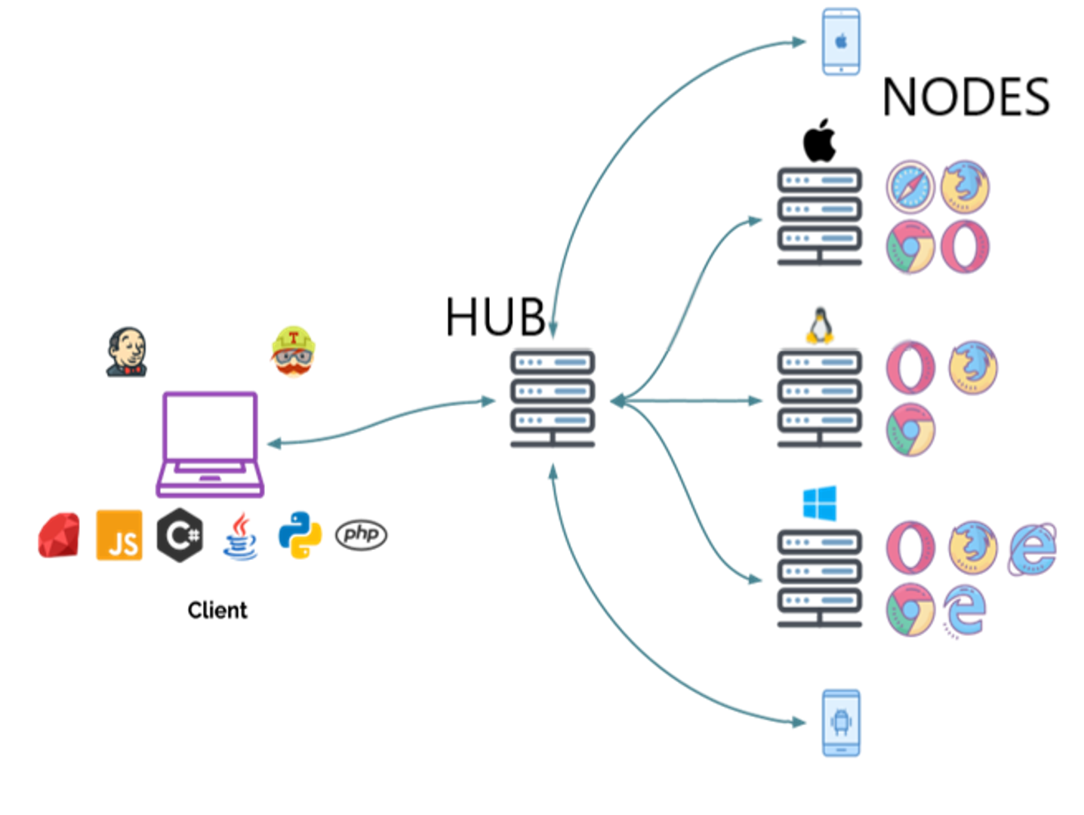
Selenium Grid
A tool for parallelizing test execution across multiple machines, browsers and platforms.
Key Features:
Parallel test execution: Distributes test cases across multiple machines for parallel execution
Browser diversity: Enables testing on different browsers such Chrome, Firefox and others
Platform diversity: Enables testing on different operating systems concurrently such Linux, Windows and others
Scalability: Scales easily to handle a large number of test cases
Notes:
Notes to the Facilitator:
Guide participants in harnessing Selenium Grid, a robust tool for parallelizing test execution, offering features like parallel test execution across multiple machines, diverse browser and platform support, and seamless scalability for handling large-scale testing scenarios.
Notes to the Participants:
Selenium Grid:
It is a tool for parallelizing test execution across multiple machines, browsers and platforms. It allows to distribute test scripts and run them simultaneously on different nodes making it suitable for large-scale testing.
Some Key Features:
Parallel test execution:
Distributes test cases across multiple machines for parallel execution
Browser diversity:
Enables testing on different browsers such Chrome, Firefox and others
Platform diversity:
Enables testing on different operating systems concurrently such Linux, Windows and others
Scalability:
Scales easily to handle a large number of test cases

Slide 10


Selenium RC
A predecessor to WebDriver and provides a way to execute tests on remote machines. While WebDriver has largely replaced Selenium RC, some legacy systems may still use it.
Key features:
No Record/Playback feature: Doesn’t support Record/Playback feature
Cross-browser testing: Supports multiple browsers
Remote execution: Allows the execution of tests on remote machines
Selenium Remote Control
Server
Client
HTTP
JAVASCEPT
Notes:
Notes to the Facilitator:
Facilitate understanding of Selenium RC as a precursor to WebDriver, emphasizing its absence of a Record/Playback feature, support for cross-browser testing, and capability to execute tests on remote machines.
Notes to the Participants:
Selenium RC :
Selenium RC (Remote Controls) is a predecessor to WebDriver and provides a way to execute tests on remote machines. While WebDriver has largely replaced Selenium RC, some legacy systems may still use it. It doesn’t support a Record/Playback feature.
Some Key Features:
No Record/Playback feature
Doesn’t support Record/Playback feature
Cross-browser testing:
Supports multiple browsers
Remote execution:
Allows the execution of tests on remote machines

Slide 11
Selenium Server
Components of Selenium 4 Architecture are:
Selenium Client Libraries
WebDriver W3C Protocol
Browser Drivers
Real Browsers
HTTP
Selenium Client Libraries
(Python, Java, Ruby, etc.)
W3C Protocol
Browser Drivers
Real Browsers
HTTP
Notes:
Notes to the Facilitator:
Guide participants in understanding Selenium 4's architecture evolution, emphasizing the transition from the older JSON Wire protocol to the more efficient WebDriver W3C Protocol.
Notes to the Participants:
Selenium 4 architecture is similar to Selenium 3. In Selenium 3, the main problem of slower test execution due to JSON Wire protocol over HTTP was solved by introduction of the W3C W3C (World Wide Web Consortium) in Selenium WebDriver 4. Hence, WebDriver W3C Protocol supersedes the older JSON Wire protocol.
Earlier, there needed to be direct communication between the Selenium client libraries and the browser driver. The older JSON Wire protocol acted as a mediator between the client libraries and the WebDriver because the server didn’t understand the programming languages but only the protocols. With Selenium 4, using the W3C protocol and the automation scripts can directly communicate with the browser.
Selenium 4 has following four major components:
Selenium Client Libraries
WebDriver W3C Protocol
Browser Drivers
Real Browsers

Slide 12
Selenium Architecture: Selenium Client Libraries
Selenium client libraries components:
Selenium provides client libraries, such as Java, Python, C#, Ruby and so on
Libraries serve as the client-side bindings
Enables communication between the test scripts and the WebDriver
Selenium Client Libraries
(Python, C#, Java, Perl, etc.)
Notes:
Notes to the Facilitator:
Explain Selenium Client Libraries component of Architecture of WeDriver 4 to the participants.
Notes to the Participants:
Client Libraries:
Selenium provides client libraries in various programming languages such as Java, Python, C#, Ruby, etc. These libraries serve as the client-side bindings that enable communication between the test scripts and the WebDriver.

Slide 13
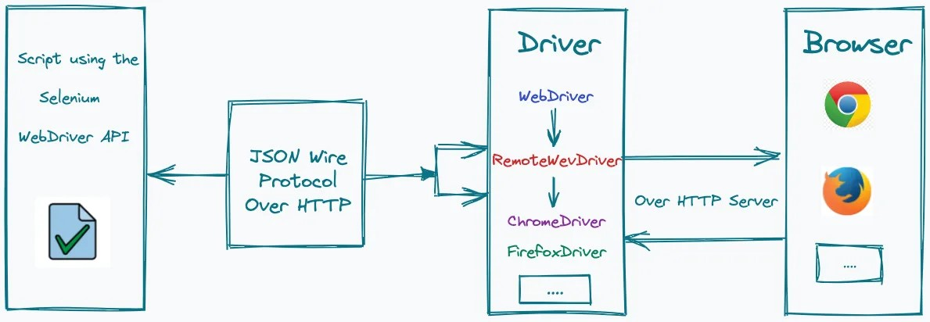
Selenium Architecture: WebDriver W3C Protocol
WebDriver W3C protocol:
Introduced in Selenium 4.0
Made by the World Wide Web Consortium (W3C)
JSON Wire Protocol not required
Selenium WebDriver and web browsers use the identical protocol
Direct information transfer between the server and client
Helps testers to work across web browsers without code change
Promotes consistency and stability
Notes:
Notes to the Facilitator:
Explain Selenium WebDriver W3C Protocol component of Architecture of WeDriver 4 to the participants.
Notes to the Participants:
WebDriver W3C Protocol:
‘WebDriver W3C’ protocol was introduced in Selenium 4.0. It was made by the World Wide Web Consortium (W3C) to standardize the WebDriver protocol which is a critical component of Selenium.
In Selenium 4, there is no need of JSON Wire Protocol as both Selenium WebDriver and web browsers use the identical protocol and there is a direct information transfer between the server and client. Automation testers would no longer need to change the automation scripts to work across various web browsers. Consistency and stability in tests are the two significant advantages of WebDriver W3C protocol in Selenium 4.0.

Slide 14
Selenium Architecture: Browser Drivers
The following are the features/components of browser drivers:
Executable files provided by browser vendors, such as:
ChromeDriver for Chrome,
EdgeDriver for Microsoft Edge
GeckoDriver for Firefox and others
Acts as intermediaries between the WebDriver and browsers
Drivers translate WebDriver commands into browser specific actions
Helps interacting with the browser by establishing a secure connection
Browser Drivers
(ChromeDriv er, FirefoxDriver Internet ExplorerDriv er, Microsoft EdgeDriver)
Notes:
Notes to the Facilitator:
Explain Selenium Browser Drivers component of Architecture of WeDriver 4 to the participants.
Notes to the Participants:
Browser Drivers:
Browser drivers are executable files provided by browser vendors such as ChromeDriver for Chrome, EdgeDriver for Microsoft Edge, GeckoDriver for Firefox, etc. They act as intermediaries between the WebDriver and the respective browsers such as Chrome, Firefox, Edge, etc. These drivers translate WebDriver commands into browser-specific actions and interacting with the browser by establishing a secure connection.

Slide 15

Selenium Architecture: Real Browsers
Selenium 4 provides support for multiple real browsers like Chrome, Firefox, Safari, Edge and others.
Notes:
Notes to the Facilitator:
Explain Selenium Real Browsers component of Architecture of WeDriver 4 to the participants.
Notes to the Participants:
Real Browsers:
Selenium 4 provides support for multiple real browsers like Chrome, Firefox, Safari, Edge and others.

Slide 16
What did You Grasp?
TestNG known as Test Next Generation is inspired by _______ and __________ testing framework?
Notes:
Notes to the Facilitator:
Answer: JUnit and Nunit

Slide 17
What did You Grasp?
Which of the following options is the component of Selenium suite?
WebDriver
IDE
Grid
Appium
Notes:
Notes to the Facilitator:
Answer: D

Slide 18

TestNG Features
The following are the key features of TestNG:
Annotations:
Define the behavior of test methods
Examples: @Test, @BeforeTest, @AfterTest, @BeforeMethod, @AfterMethod
Above annotations help in defining the test sequence
Test Configuration:
Configuration of test environments can be performed through annotations and XML files
Examples
Setting up preconditions
Configuring test data
Defining parallel execution settings
Parameterization:
TestNG supports parameterization of test methods
Supports the same test to be executed with different sets of input data
Use the @Parameters annotation
Notes:
Notes to the Facilitator:
Guide participants on TestNG's annotation-driven approach, including key annotations.
Notes to the Participants:
Annotations:
TestNG uses annotations to define the behavior of test methods
Examples are
@Test, @BeforeTest, @AfterTest, @BeforeMethod, @AfterMethod
Above annotations help in defining the test sequence
Test Configuration:
Configuration of test environments can be performed through annotations and XML files
Examples
Setting up preconditions
Configuring test data
Defining parallel execution settings
Parameterization:
TestNG supports parameterization of test methods
Supports the same test to be executed with different sets of input data
Use the @Parameters annotation

Slide 19
TestNG Features (Contd…)
The following are the key features of TestNG:
Dependency Management:
TestNG supports definition of dependencies between test methods
Ensures that a particular test method runs only if its dependent methods have passed
Groups:
Group test methods and execute test based on these groups
Crucial for selectively running specific sets of tests
Parallel Execution:
TestNG supports parallel execution of tests at different levels: methods, classes and suites
Optimal use of resources and faster execution tests
Listeners:
Use listeners to perform actions or log information during test execution
Implement custom listeners by extending TestNG's default behavior
Notes:
Notes to the Facilitator:
Facilitate understanding of TestNG's advanced features, including dependency management ensuring sequential test execution, grouping for selective test runs, parallel execution at various levels.
Notes to the Participants:
Dependency Management:
TestNG supports definition of dependencies between test methods
Ensures that a particular test method runs only if its dependent methods have passed
Groups:
Group test methods and execute test based on these groups
Crucial for selectively running specific sets of tests
Parallel Execution:
TestNG supports parallel execution of tests
Test can be executed at different levels: methods, classes and suites
Optimal use of resources and faster execution tests
Listeners:
TestNG provides the ability to use listeners to perform actions or log information during test execution
Custom listeners can be implemented to extend TestNG's default behavior

Slide 20
TestNG Features (Contd…)
The following are the key features of TestNG:
Assertions:
TestNG includes a rich set of assertions for verifying expected outcomes
Checking equality, existence, true/false conditions and more
Data Providers:
Use data providers to supply test data to test methods
Crucial for data-driven testing scenarios.
Reporting:
TestNG generates detailed HTML reports
Provides information regarding: test execution, pass/fail status, test durations and stack traces for failed tests
Notes:
Notes to the Facilitator:
Instruct participants on TestNG's comprehensive assertion methods for outcome validation, the effective use of data providers in data-driven testing, and the automatic generation of detailed HTML reports, providing insights into test execution, pass/fail status, test durations, and stack traces for failed tests.
Notes to the Participants:
Assertions:
TestNG includes a rich set of assertion methods for verifying expected outcomes
Assertions include methods for checking equality, existence, true/false conditions and more
Data Providers:
TestNG supports the use of data providers to supply test data to test methods
Crucial for data-driven testing scenarios.
Reporting:
TestNG generates detailed HTML reports
Provides information regarding: test execution, pass/fail status, test durations and stack traces for failed tests

Slide 21
TestNG and JUnit: Differences
The following are the key differences between TestNG and JUnit:
JUnit is older than TestNG.
TestNG is more feature rich which is good especially for larger and more complex test suites
TestNG generates detailed HTML reports, including information about pass/fail status, test durations, and stack traces for failed tests
TestNG has native support for parallel execution at the method, class, and suite levels, making it easier to run tests concurrently, while Junit supports parallel test execution with additional configuration.
TestNG has built-in support for grouping test methods, allowing us to categorize whereas Junit doesn't provide built-in support for grouping
TestNG provides a more extensive set of annotations such as @Test, @BeforeTest, @AfterTest, @BeforeMethod, @AfterMethod, and more that allows more fine grained control
Notes:
Notes to the Facilitator:
Highlight the nuanced differences between TestNG and JUnit, emphasizing TestNG's feature-rich nature for larger test suites.
Notes to the Participants:
TestNG and Junit testing frameworks have their unique features and the choice between them mostly depends on project requirements and the testing scenarios. Many projects use a combination of both by leveraging the strengths of each framework.
Lets discuss some of the key differences between TestNG and Junit:
JUnit is older and has been widely adopted in the Java community. TestNG is more feature rich which is good especially for larger and more complex test suites
In compare to Junit, TestNG generates detailed HTML reports, including information about pass/fail status, test durations, and stack traces for failed tests
While Junit supports parallel test execution with additional configuration, TestNG has native support for parallel execution at the method, class, and suite levels, making it easier to run tests concurrently
TestNG has built-in support for grouping test methods, allowing us to categorize whereas Junit doesn't provide built-in support for grouping
TestNG provides a more extensive set of annotations such as @Test, @BeforeTest, @AfterTest, @BeforeMethod, @AfterMethod, and more that allows more fine grained control

Slide 22
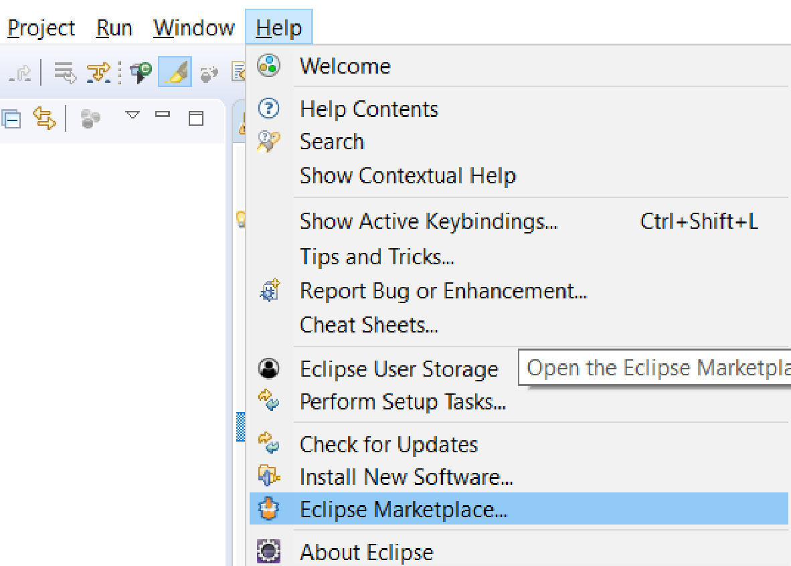
Configuring TestNG With Eclipse
The steps for downloading, installing and configuring TestNG with eclipse.
1. Open Eclipse and Go to Help> Eclipse Marketplace.
Notes:
Notes to the Facilitator:
Explain steps for configuring TestNG with Eclipse to the participants.
Notes to the Participants:
Configuring TestNG with Eclipse requires several steps that includes installing the TestNG plugin. Below are the steps for downloading, installing and configuring TestNG with eclipse.
1. Open Eclipse and Go to Help> Eclipse Marketplace.

Slide 23
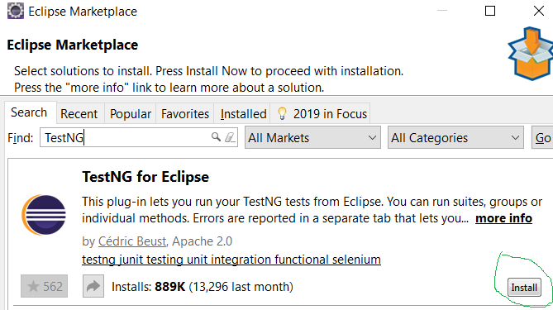
Configuring TestNG With Eclipse
2. In the Eclipse Marketplace dialog, type "TestNG" into the search bar.
Notes:
Notes to the Facilitator:
Explain steps for configuring TestNG with Eclipse to the participants.
Notes to the Participants:
2. In the Eclipse Marketplace dialog, type "TestNG" into the search bar.

Slide 24
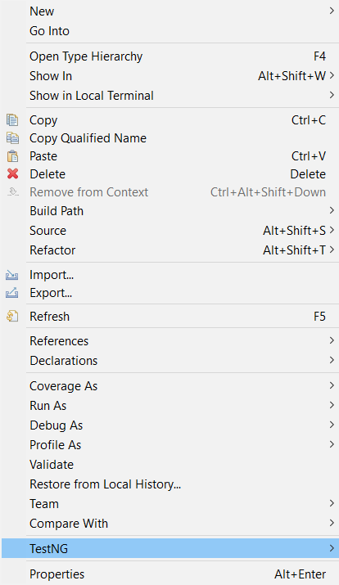
Configuring TestNG With Eclipse
3. Click on install to download and install TestNG framework.
4. If TestNG is already installed in Eclipse.
Installed’ button will appear
Meaning TestNG framework is already installed
5. Restart Eclipse to use the features of the installed plugin.
6. After restart, verify if TestNG option is available or not for creating a TestNG class.
Notes:
Notes to the Facilitator:
Explain steps for configuring TestNG with Eclipse to the participants.
Notes to the Participants:
Click on install and TestNG framework will be installed in your Eclipse. If TestNG is already installed in your Eclipse than the ‘Installed’ button will appear
Restart Eclipse to use the features of the installed plugin
After restart, verify if TestNG option is available or not for creating a TestNG class

Slide 25
Writing Selenium Scripts From Scratch
Steps for writing Selenium test scripts with TestNG:
Project Setup
Create a New Java Project:
Open Eclipse or preferred Java IDE
Create a new Java project
Add Selenium WebDriver and TestNG Dependencies:
Add Selenium WebDriver and TestNG libraries to the project
If using Maven, add dependencies in your pom.xml file
If not using Maven, download the Selenium WebDriver JARs and TestNG JARs and add them to the project's build path
Notes:
Notes to the Facilitator:
Explain project steps for configuring TestNG with Eclipse to the participants.
Notes to the Participants:
Steps for writing Selenium test scripts with TestNG
Project Setup:
Create a New Java Project:
Open Eclipse or preferred Java IDE
Create a new Java project
Add Selenium WebDriver and TestNG Dependencies
Add Selenium WebDriver and TestNG libraries to the project
If using Maven, add dependencies in your pom.xml file
If not using Maven, download the Selenium WebDriver JARs and TestNG JARs and add them to the project's build path

Slide 26
Writing Selenium Scripts From Scratch
Write a Selenium Script:
Create a Test Class:
Create a new class in your project for your Selenium test
Import necessary packages:
import org.openqa.selenium.WebDriver;
import org.openqa.selenium.chrome.ChromeDriver;
import org.TestNG.annotations.Test;
Notes:
Notes to the Facilitator:
Explain importing required libraries for writing test script for configuring TestNG with Eclipse to the participants.
Notes to the Participants:
Write a Selenium Script:
Create a Test Class:
Create a new class in your project for your Selenium test
Import necessary packages:
import org.openqa.selenium.WebDriver;
import org.openqa.selenium.chrome.ChromeDriver;
import org.TestNG.annotations.Test;
Write a Test Method
Write a TestNG test method
For example:
public class MyFirstSeleniumTest {
@Test
public void myFirstTest() {
System.setProperty("webdriver.chrome.driver", "path/to/chromedriver");
WebDriver driver = new ChromeDriver();
driver.get("https://www.mydomain.com");
System.out.println("Page Title: " + driver.getTitle());
driver.quit();
}
}

Slide 27
Writing Selenium Scripts From Scratch
Write a Selenium Script:
Write a Test Method
Write a TestNG test method
For example:
public class MyFirstSeleniumTest {
@Test
public void myFirstTest() {
System.setProperty("webdriver.chrome.driver", "path/to/chromedriver");
WebDriver driver = new ChromeDriver();
driver.get("https://www.mydomain.com");
System.out.println("Page Title: " + driver.getTitle());
driver.quit();
}
}
Notes:
Notes to the Facilitator:
Explain steps for writing selenium test method for configuring TestNG with Eclipse to the participants.
Notes to the Participants:
Write a Selenium Script:
Write a Test Method
Write a TestNG test method
For example:
public class MyFirstSeleniumTest {
@Test
public void myFirstTest() {
System.setProperty("webdriver.chrome.driver", "path/to/chromedriver");
WebDriver driver = new ChromeDriver();
driver.get("https://www.mydomain.com");
System.out.println("Page Title: " + driver.getTitle());
driver.quit();
}
}

Slide 28
Writing Selenium Scripts From Scratch
Write a Selenium Script:
Configure TestNG XML File
Create a TestNG XML file to configure your test suite
Create a file named TestNG.xml with the following content
<suite name="MyFirstTestSuite">
<test name="MyFirstTest">
<classes>
<class name="com.mydomain.MyFirstSeleniumTest"/>
</classes>
</test>
</suite>
Notes:
Notes to the Facilitator:
Explain TestNG XML configuration steps for configuring TestNG with Eclipse to the participants.
Notes to the Participants:
Configure TestNG XML File
Create a TestNG XML file to configure your test suite
Create a file named TestNG.xml with the following content
<suite name="MyFirstTestSuite">
<test name="MyFirstTest">
<classes>
<class name="com.mydomain.MyFirstSeleniumTest"/>
</classes>
</test>
</suite>

Slide 29
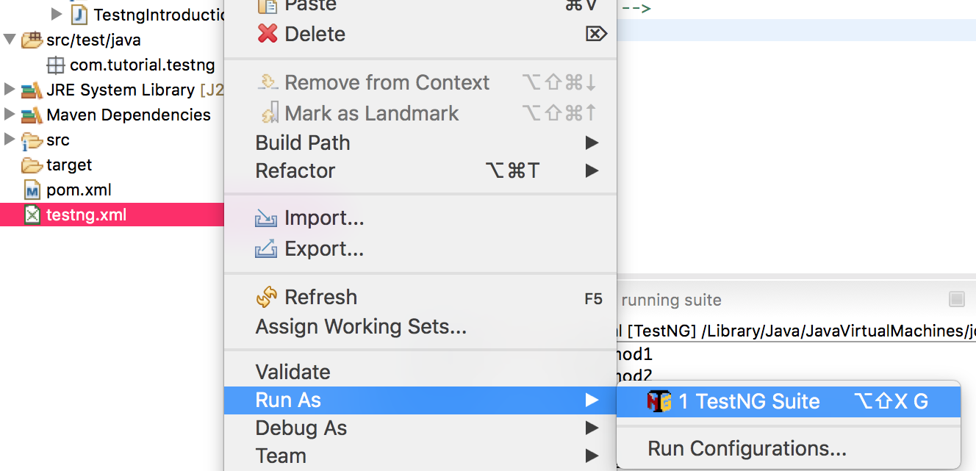
Test Run & Reports
Steps to Run the TestNG Test Suite:
Right-click on your TestNG.xml file
Select "Run As" > "TestNG Suite."
Observe the execution of your Selenium test in the console
The browser should open
Navigate to https://www.mydomain.com,
Print the page title and then close
After running test, HTML report available in the test-output directory within the project
Notes:
Notes to the Facilitator:
Explain how to run the TestNG and observe results with Eclipse to the participants.
Notes to the Participants:
Steps to Run the TestNG Test Suite:
Right-click on your TestNG.xml file
Select "Run As" > "TestNG Suite."
Observe the execution of your Selenium test in the console
The browser should open
Navigate to https://www.mydomain.com,
Print the page title and then close
After running test, HTML report available in the test-output directory within the project

Slide 30
What did You Grasp?
TestNG is more feature rich and suitable for larger and more complex test suites.
True
False
Notes:
Notes to the Facilitator:
Answer: True

Slide 31
What did You Grasp?
TestNG has native support for parallel execution at the method, class, and suite levels.
True
False
Notes:
Notes to the Facilitator:
Answer: True

Slide 32
What did You Grasp?
In compare to TestNG, JUnit generates detailed HTML reports.
True
False
Notes:
Notes to the Facilitator:
Answer: False

Slide 33

TestNG Annotations
The following are some of the key points of TestNG annotations:
Additional tags in the code
Provide metadata about code to the TestNG framework
TestNG uses annotations to define:
Configurations
Behavior of test methods
Annotations help in:
Controlling the flow of the test suite
Setting up preconditions
Performing actions after test execution
@Before Suite
@After Suite
@Before Test
@After Test
@Before Class
List of TestNG
Annotations
@After class
@Before Method
@After Method
@Before Groups
@After Groups
Notes:
Notes to the Facilitator:
Guide participants on the significance of TestNG annotations, serving as additional metadata to define test method configuration and behavior, enabling control over test suite flow, preconditions setup, and post-test execution actions
Notes to the Participants:
TestNG uses annotations to define the configuration and behavior of test methods. Annotations additional tags in the code that provide additional metadata about the code to the TestNG framework.
Annotations help in controlling the flow of the test suite, setting up preconditions and performing actions after test execution.
Some commonly used TestNG annotations as discussed in the next slide:

Slide 34
TestNG Annotations: @BeforeSuite, @AfterSuite
The following are some of the TestNG annotations:
@BeforeSuite Annotation:
Used to indicate that a method should run before all tests in a suite.
Example
@BeforeSuite
public void setupBeforeSuite() {
// Setup logic before the entire suite runs
}
@AfterSuite Annotation:
Used to indicate that a method should run after all tests in a suite
Example
@AfterSuite
public void cleanupAfterSuite() {
// Cleanup logic after the entire suite runs
}
Notes:
Notes to the Facilitator:
Explain TestNG Annotations to the participants.
Notes to the Participants:
@BeforeSuite Annotation:
Used to indicate that a method should run before all tests in a suite.
Example
@BeforeSuite
public void setupBeforeSuite() {
// Setup logic before the entire suite runs
}
@AfterSuite Annotation:
Used to indicate that a method should run after all tests in a suite
Example
@AfterSuite
public void cleanupAfterSuite() {
// Cleanup logic after the entire suite runs
}

Slide 35
TestNG Annotations: @BeforeTest, @AfterTest
The following are some of the TestNG annotations:
@BeforeTest Annotation:
Used to indicate that a method should run before any test method belonging to the <test> tag runs
Example
@BeforeTest
public void setupBeforeTest() {
// Setup logic before any test in the suite runs
}
@AfterTest Annotation:
Used to indicate that a method should run after all the test methods belonging to the <test> tag run
Example
@AfterTest
public void cleanupAfterTest() {
// Cleanup logic after all tests in the suite run
}
Notes:
Notes to the Facilitator:
Explain TestNG Annotations to the participants.
Notes to the Participants:
@BeforeTest Annotation:
Used to indicate that a method should run before any test method belonging to the <test> tag runs
Example
@BeforeTest
public void setupBeforeTest() {
// Setup logic before any test in the suite runs
}
@AfterTest Annotation:
Used to indicate that a method should run after all the test methods belonging to the <test> tag run
Example
@AfterTest
public void cleanupAfterTest() {
// Cleanup logic after all tests in the suite run
}

Slide 36
TestNG Annotations: @BeforeClass, @AfterClass
The following are some of the TestNG annotations:
@BeforeClass Annotation:
Used to indicate that a method should run before the first test method in the current class
Example
@BeforeClass
public void setupBeforeClass() {
// Setup logic before the first test method in the class runs
}
@AfterClass Annotation:
Used to indicate that a method should run after all the test methods in the current class
Example
@AfterClass
public void cleanupAfterClass() {
// Cleanup logic after all test methods in the class run
}
Notes:
Notes to the Facilitator:
Explain TestNG Annotations to the participants.
Notes to the Participants:
@BeforeClass Annotation:
Used to indicate that a method should run before the first test method in the current class
Example
@BeforeClass
public void setupBeforeClass() {
// Setup logic before the first test method in the class runs
}
@AfterClass Annotation:
Used to indicate that a method should run after all the test methods in the current class
Example
@AfterClass
public void cleanupAfterClass() {
// Cleanup logic after all test methods in the class run
}

Slide 37
TestNG Annotations:@BeforeMethod, @AfterMethod
The following are some of the TestNG annotations:
@BeforeMethod Annotation:
Used to indicate that a method should run before each test method
Example
@BeforeMethod
public void setupBeforeMethod() {
// Setup logic before each test method runs
}
@AfterMethod Annotation:
Used to indicate that a method should run after each test method
Example
@AfterMethod
public void cleanupAfterMethod() {
// Cleanup logic after each test method runs
}
Notes:
Notes to the Facilitator:
Explain TestNG Annotations to the participants.
Notes to the Participants:
@BeforeMethod Annotation:
Used to indicate that a method should run before each test method
Example
@BeforeMethod
public void setupBeforeMethod() {
// Setup logic before each test method runs
}
@AfterMethod Annotation:
Used to indicate that a method should run after each test method
Example
@AfterMethod
public void cleanupAfterMethod() {
// Cleanup logic after each test method runs
}

Slide 38
TestNG Annotations:@BeforeGroups, @AfterGroups
The following are some of the TestNG annotations:
@BeforeGroups Annotation:
Used to specify a method that should run before the execution of a specific group of test method
Example
@BeforeGroups("groupA")
public void beforeGroupA() {
// logic before specific test method runs
}
@AfterGroups Annotation:
Used to specify a method that should run after the execution of a specific group of test methods
Example
@AfterMethod
public void afterGroupA () {
// logic after specific test method runs}
Notes:
Notes to the Facilitator:
Explain TestNG Annotations to the participants.
Notes to the Participants:
@BeforeGroups Annotation:
Used to specify a method that should run before the execution of a specific group of test method
Example
@BeforeGroups("groupA")
public void beforeGroupA() {
// logic before specific test method runs
}
@AfterGroups Annotation:
Used to specify a method that should run after the execution of a specific group of test methods
Example
@AfterMethod
public void afterGroupA () {
// logic after specific test method runs}

Slide 39
What did You Grasp?
TestNG annotations helps in ____ ?
Controlling the flow of the test suite
Setting up preconditions
Performing actions after test execution
All of the above
Notes:
Notes to the Facilitator:
Answer: D

Slide 40
What did You Grasp?
Which TestNG annotation is used to indicate that a method should run before any test method belonging to the <test> tag runs?
@BeforeTest
@BeforeMethod
@BeforeSuite
Notes:
Notes to the Facilitator:
Answer: A

Slide 41
What did You Grasp?
Which TestNG annotation is used to indicate that a method should run before each test method?
@BeforeTest
@BeforeMethod
@BeforeSuite
Notes:
Notes to the Facilitator:
Answer: B

Slide 42
What did You Grasp?
Which TestNG annotation is used to indicate that a method should run before all tests in a suite?
@BeforeTest
@BeforeMethod
@BeforeSuite
Notes:
Notes to the Facilitator:
Answer: C

Slide 43
TestNG Assertions
TestNG assertions:
Are used to validate the expected outcome of a test.
Done by comparing the actual result with the expected result
Types of Assertion
Hard Assertion
Soft Assertion
Notes:
Notes to the Facilitator:
Explain the types of asserts in TestNG, that is Hard Assert and Soft Assert in TestNG to the participants.
Notes to the Participants:
TestNG assertions are used to validate the expected outcome of a test. This is done by comparing the actual result with the expected result, if both match the TestNG test is marked as pass otherwise it is marked as fail.
TestNG supports both hard assertions as well as soft assertions.

Slide 44
Hard Assertion
Hard Assertions in TestNG are:
Stops the execution of the test as assertion failure occurs.
If a hard assertion is applied and an assertion statement fails then:
TestNG throws an exception immediately
Terminates the further execution of the same test case
Continues with the next test case in the test suite
Primary class for hard assertions in TestNG is Assert.
Notes:
Notes to the Facilitator:
Facilitate understanding of hard assertions in TestNG, where failures halt test execution immediately, utilizing the Assert class for streamlined assertion handling and seamless continuation with the next test case in the suite.
Notes to the Participants:
Hard Assertions:
Hard assertions are straightforward and stop the execution of the test as soon as an assertion failure occurs. For example if a hard assertion is applied and an assertion statement fails then the assertion in TestNG throws an exception immediately and terminates the further execution of the same test case and simply continues with the execution of the next test case in the test suite.
The primary class for hard assertions in TestNG is Assert.

Slide 45
Hard Assertion Example
The following code snippet displays an example of hard assertion:
import org.TestNG.Assert;
import org.TestNG.annotations.Test;
public class HardAssertionExample {
@Test
public void testHardAssertions() {
String actualString = “TestNG is best";
String expectedString = " TestNG is best";
int actualNumber = 7782;
int expectedNumber = 7782;
Assert.assertEquals(actualString, expectedString, "Failed");
Assert.assertEquals(actualNumber, expectedNumber, "Failed");
System.out.println("Test Completed");
}
}
Notes:
Notes to the Facilitator:
Describe an example of Hard Assert in TestNG as the comment in the code in note section to the participants.
Notes to the Participants:
In the given example code for hard assert, if any assertion fails then the test will stop immediately and subsequent code will not be executed. The test can fail if the strings - actualString and expectedString are not equal or the numbers - actualNumber and expectedNumber are not equal.
import org.TestNG.Assert;
import org.TestNG.annotations.Test;
public class HardAssertionExample {
@Test
public void testHardAssertions() {
String actualString = "TestNG is best";
String expectedString = "TestNG is best";
int actualNumber = 7782;
int expectedNumber = 7782;
// Hard assertion check for equality
Assert.assertEquals(actualString, expectedString, “Failed");
// Hard assertion for check equality
Assert.assertEquals(actualNumber, expectedNumber, “Failed");
// This line will be executed only if the previous assertions pass
System.out.println("Test Completed");
}
}

Slide 46
Soft Assertion
Soft Assertions:
Allow the test to continue even after an assertion failure
Useful to record multiple failures in a single test and report them collectively
If a soft assertion fails then TestNG doesn’t throw exception
Instead, all the statements are executed
Result of all the assertions are collected
Test cases are marked passed or failed based on the assertion result
TestNG provides the SoftAssert class for soft assertions
Notes:
Notes to the Facilitator:
Introduce participants to the concept of soft assertions in TestNG, allowing tests to continue after assertion failures, facilitating the collection of multiple failures in a single test, and highlighting the use of TestNG's SoftAssert class for implementing soft assertions.
Notes to the Participants:
Soft assertions allow the test to continue even after an assertion failure. This can be useful when you want to record multiple failures in a single test and report them collectively at the end. For example if a soft assertion fails then TestNG doesn’t throw exception. Instead, all the statements are executed. The test then collects the result of all the assertions and marks the test case as passed or failed based on the assertion result.
TestNG provides the SoftAssert class for soft assertions.

Slide 47
Soft Assertion Example
The following code snippet displays an example of soft assertion:
import org.TestNG.asserts.SoftAssert;
import org.TestNG.annotations.Test;
public class SoftAssertionExample {
@Test
public void testSoftAssertions() {
String actualString = "TestNG is best";
String expectedString = "TestNG is not best";
int actualNumber = 7782;
int expectedNumber = 7783;
SoftAssert softAssert = new SoftAssert();
softAssert.assertEquals(actualString, expectedString, “Failed");
softAssert.assertEquals(actualNumber, expectedNumber, “Failed");
System.out.println("Test completed");
softAssert.assertAll();
}
}
Notes:
Notes to the Facilitator:
Describe an example of Soft Assert in TestNG as the comment in the code in note section to the participants.
Notes to the Participants:
In the given example code for hard assert, both assertions will be checked and any failures will be recorded by the SoftAssert. Though both the assert is going to fail in the given example, the test will continue to execute and the assertAll() method at the end will throw an exception if there are any failures. This will allow to capture multiple failures before ending the test.
import org.TestNG.asserts.SoftAssert;
import org.TestNG.annotations.Test;
public class SoftAssertionExample {
@Test
public void testSoftAssertions() {
String actualString = "TestNG is best";
String expectedString = "TestNG is not best";
int actualNumber = 7782;
int expectedNumber = 7783;
SoftAssert softAssert = new SoftAssert();
// Soft assertion check for equality if actualString == expectedString
softAssert.assertEquals(actualString, expectedString, “Failed");
// Soft assertion check for equality if actualNumber == expectedNumber
softAssert.assertEquals(actualNumber, expectedNumber, “Failed");
// This line will be executed even if the assertions fail
System.out.println("Test completed");
// Trigger check for any failures
softAssert.assertAll();
}
}

Slide 48
Prioritize Execution Order of Tests
TestNG provides a way to prioritize the execution order of tests
Use priority attribute of the @Test annotation to assign a priority
Lower priority values run before higher priority values
By default, the priority is set to 0
All tests with same priority are executed in an alphabetic order
Syntax:
@Test (priority = x)
where x can be any integer from negative, zero, or positive
For Example:
@Test (priority = 1)
public void function(){
//test code
}
Notes:
Notes to the Facilitator:
Explain about prioritizing the execution order of test to the participants.
Notes to the Participants:
TestNG provides a way to prioritize the execution order of tests. We can use the priority attribute of the @Test annotation to assign a priority to each test method. Lower priority values run before higher priority values. Prioritizing is crucial when we have multiple test cases and want to execute them in a particular order.
By default, the priority is set to 0 if not specified. Since all tests are having same priority, it executes in an alphabetic order.
Syntax for test priority is @Test (priority = x), where x can be any integer from negative, zero, or positive.
For Example,
@Test (priority = 1)
public void function(){
//test code
}

Slide 49
Prioritize Execution Order Of Tests
The following code snippet displays an example of prioritizing execution order of the test:
import org.TestNG.annotations.Test;
public class TestPriorityExample {
@Test(priority = 0)
public void testMethod0() {
System.out.println("testMethod0");
}
@Test(priority = 1)
public void testMethod1() {
System.out.println("testMethod1");
}
@Test(priority = 2)
public void testMethod2() {
System.out.println("testMethod2");
}
}
Notes:
Notes to the Facilitator:
Explain example of prioritizing the execution order of test to the participants.
Notes to the Participants:
In given example code, we can see that the testMethod0 has the lowest priority (0), testMethod1 has a priority of 1 and testMethod2 has the highest priority 2.
Hence, testMethod0 will be printed first then testMethod1 and then testMethod2
import org.TestNG.annotations.Test;
public class TestPriorityExample {
@Test(priority = 0)
public void testMethod0() {
System.out.println("testMethod0");
}
@Test(priority = 1)
public void testMethod1() {
System.out.println("testMethod1");
}
@Test(priority = 2)
public void testMethod2() {
System.out.println("testMethod2");
}
}

Slide 50
TestNG Reports
TestNG Reporting Feature:
Help analyzing the results of test executions
can be used to generate detailed HTML reports
Makes easier to identify test failures, understand test execution flow and share test results with stakeholders
Steps involved in creating TestNG report:
Install TestNG
Create and Run Test Suite
Enable TestNG Reports
Add ExtentReports Dependency
Run Test Suite and View Reports
Notes:
Notes to the Facilitator:
Facilitate participants in leveraging TestNG's robust reporting capabilities for in-depth analysis of test results.
Notes to the Participants:
TestNG provides comprehensive reporting features to help analyze the results of our test executions. The reporting capabilities of TestNG can be used to generate detailed HTML reports making it easier to identify test failures, understand test execution flow and share test results with stakeholders.
There are several steps involved in creating TestNG report:
Install TestNG
Create and Run Test Suite
Enable TestNG Reports
Add ExtentReports Dependency
Run Test Suite and View Reports

Slide 51
Step 1: Install TestNG
A detailed view of the steps to create TestNG report:
Install TestNG:
Install TestNG in your project
Either add TestNG as a dependency in your build tool such as Maven or Gradle
Or download TestNG JAR files directly
Notes:
Notes to the Facilitator:
Explain Install and Create Test Suite step of creating TestNG Reports to the participants.
Notes to the Participants:
TestNG provides comprehensive reporting features to help analyze the results of our test executions. The reporting capabilities of TestNG can be used to generate detailed HTML reports making it easier to identify test failures, understand test execution flow and share test results with stakeholders.
There are several steps involved in creating TestNG report:
1. Install TestNG:
Install TestNG in your project by adding TestNG as a dependency in your build tool such as Maven or Gradle or download TestNG JAR files directly.

Slide 52
Step 2: Create and Run Test Suite
A detailed view of the steps to create TestNG report:
Create and Run Test Suite:
Create a TestNG XML file (TestNG.xml)
Include the classes or methods you want to run as a suite
Configure the suite with parameters such as parallel execution, thread count, etc
Execute the test suite
Notes:
Notes to the Facilitator:
Explain Install and Create Test Suite step of creating TestNG Reports to the participants.
Notes to the Participants:
TestNG provides comprehensive reporting features to help analyze the results of our test executions. The reporting capabilities of TestNG can be used to generate detailed HTML reports making it easier to identify test failures, understand test execution flow and share test results with stakeholders.
There are several steps involved in creating TestNG report:
2. Create and Run Test Suite:
Create a TestNG XML file (TestNG.xml) that includes the classes or methods you want to run as a suite. Configure the suite with parameters such as parallel execution, thread count, etc. Execute the test suite using your preferred method such as command line, IDE or build tool).

Slide 53
Step 3: Enable TestNG Reports
A detailed view of the steps to create TestNG report:
Enable TestNG Reports:
Default HTML reports are generated automatically by TestNG
To enable detailed reports, use @Listeners annotation
Specify the ExtentTestNGITestListener class provided by the ExtentReports library
Sample example in Java
import com.aventstack.extentreports.TestNG.listener.ExtentTestNGITestListener;
import org.TestNG.annotations.Listeners;
@Listeners({ExtentTestNGITestListener.class})
public class MyTestClass {
// Your test methods here
}
Notes:
Notes to the Facilitator:
Explain Enable TestNG Reports to the participants.
Notes to the Participants:
3. Enable TestNG Reports:
Default HTML reports are generated automatically by TestNG. To enable more detailed reports, we can use the @Listeners annotation and specify the ExtentTestNGITestListener class provided by the ExtentReports library. ExtentReports is a popular reporting library because it integrates easily with TestNG.
Sample example in Java
import com.aventstack.extentreports.TestNG.listener.ExtentTestNGITestListener;
import org.TestNG.annotations.Listeners;
@Listeners({ExtentTestNGITestListener.class})
public class MyTestClass1 {
// Your test methods here
}

Slide 54
Step 4: Add ExtentReports
A detailed view of the steps to create TestNG report:
Add ExtentReports Dependency:
Add the ExtentReports dependency to your project
Add as a dependency through Maven or Gradle or download JAR
Maven Configuration
<dependency>
<groupId>com.aventstack</groupId>
<artifactId>extentreports</artifactId>
<version>5.1.1</version>
</dependency>
Notes:
Notes to the Facilitator:
Explain how to add ExtentReports Dependency and Run Test Suite to View Reports using TestNG Reports to the participants.
Notes to the Participants:
4. Add ExtentReports Dependency:
Add the ExtentReports dependency to your project by adding it as a dependency in your build tool such as Maven or Gradle or download JAR file directly.
Maven Configuration
<dependency>
<groupId>com.aventstack</groupId>
<artifactId>extentreports</artifactId>
<version>5.1.1</version>
</dependency>

Slide 55
Step 5: Run and View Report
A detailed view of the steps to create TestNG report:
Run Test Suite and View Reports:
Execute your TestNG test suite
Go to to the specified report location
By default, TestNG reports are generated in the "test-output" directory
Notes:
Notes to the Facilitator:
Explain how to add ExtentReports Dependency and Run Test Suite to View Reports using TestNG Reports to the participants.
Notes to the Participants:
5. Run Test Suite and View Reports
Execute your TestNG test suite. After run completion, goto to the specified report location. By default, TestNG reports are generated in the "test-output" directory.

Slide 56
Configuring Ant, Run and View XSLT Report
Apache Ant:
A Java-based build tool that is used for automating software build processes
Can be used with TestNG for running test suites and generating XSLT reports
Steps to configure Apache Ant for running TestNG tests:
Download and Extract Ant:
Download latest Apache Ant from official website
https://ant.apache.org/
Extract the downloaded archive to a directory
Notes:
Notes to the Facilitator:
Explain Configuring Ant For TestNG to the participants.
Notes to the Participants:
Apache Ant is a Java-based build tool that is used for automating software build processes. It can be use with TestNG for running test suites and generating reports. Configuring Apache Ant for TestNG involves creating a build.xml file that defines tasks for compiling source code and running TestNG tests.
Steps to configure Apache Ant for running TestNG tests:
1. Download and Extract Ant:
Download latest binary distribution of Apache Ant from official website https://ant.apache.org/
Extract the downloaded archive to a directory

Slide 57
Configuring Ant, Run and View XSLT Report Contd…
Set ANT_HOME:
Set the ANT_HOME environment variable to the directory where you extracted Apache Ant
On Windows, we can set it in the Environment Variables in System Properties
On Linux or macOS, we can add the following line to your ~/.bashrc or ~/.bash_profile
export ANT_HOME=/path/to/your/ant/directory
Add ANT_HOME to PATH:
Add the bin directory within ANT_HOME to your PATH environment variable
On Windows, you can add %ANT_HOME%\bin to the PATH
On Linux or macOS, use the following command
export PATH=$PATH:$ANT_HOME/bin
Create Build.xml:
Create a build.xml file in the root of your project
This file will contain the configuration for running TestNG tests
Notes:
Notes to the Facilitator:
Explain Configuring Ant For TestNG to the participants.
Notes to the Participants:
Apache Ant is a Java-based build tool that is used for automating software build processes. It can be use with TestNG for running test suites and generating reports. Configuring Apache Ant for TestNG involves creating a build.xml file that defines tasks for compiling source code and running TestNG tests.
Steps to configure Apache Ant for running TestNG tests:
2. Download and Extract Ant:
Download latest binary distribution of Apache Ant from official website https://ant.apache.org/
Extract the downloaded archive to a directory
3. Set ANT_HOME
Set the ANT_HOME environment variable to the directory where you extracted Apache Ant
On Windows, we can set it in the Environment Variables in System Properties
On Linux or macOS, we can add the following line to your ~/.bashrc or ~/.bash_profile
export ANT_HOME=/path/to/your/ant/directory
4. Add ANT_HOME to PATH
Add the bin directory within ANT_HOME to your PATH environment variable
On Windows, you can add %ANT_HOME%\bin to the PATH
On Linux or macOS, use the following command
export PATH=$PATH:$ANT_HOME/bin
Create Build.xml
Create a build.xml file in the root of your project
This file will contain the configuration for running TestNG tests

Slide 58
Configuring Ant, Run and View XSLT Report Contd…
Directory Structure:
Ensure your project has a directory structure similar to the following:
project-root/
|-- build.xml
|-- src/
| `-- (your source files)
|-- lib/
| `-- (TestNG and other JARs)
|-- build/
|-- TestNG-reports/
Notes:
Notes to the Facilitator:
Explain Configuring Ant For TestNG to the participants.
Notes to the Participants:
5. Directory Structure
Ensure your project has a directory structure similar to the following:
project-root/
|-- build.xml
|-- src/
| `-- (your source files)
|-- lib/
| `-- (TestNG and other JARs)
|-- build/
|-- TestNG-reports/

Slide 59
Configuring Ant, Run and View XSLT Report Contd…
The following are the steps to Ant, Run & View XSLT report:
Run ANT Build:
Open a terminal or command prompt in the project root directory
Run the following command to run ant build
ant run-tests
View XSLT Reports:
Navigate to the TestNG-reports directory
Open the index.html file to view the XSLT reports generated by TestNG
Notes:
Notes to the Facilitator:
Explain Run ANT Build and View XSLT Reports to the participants.
Notes to the Participants:
Run ANT Build
Open a terminal or command prompt in the project root directory
Run the following command to run ant build
ant run-tests
View XSLT Reports
Navigate to the TestNG-reports directory
Open the index.html file to view the XSLT reports generated by TestNG

Slide 60
What did You Grasp?
Does Hard Assertions immediately stops the execution of the test if assertion failure occurs?
Yes
No
Notes:
Notes to the Facilitator:
Answer: Yes

Slide 61
What did You Grasp?
Soft assertions allow the test to continue even after an assertion failure?
True
False
Notes:
Notes to the Facilitator:
Answer: True

Slide 62
What did You Grasp?
What is the name of the class TestNG provides for soft assertions?
AssertNG
SoftAssertion
SoftAssert
AssertionNG
Notes:
Notes to the Facilitator:
Q3. SoftAssert

Slide 63
In a nutshell
In this module, we learnt:
Introduction to selenium and TestNG
Selenium components
Selenium architecture
TestNG, features
TestNG comparison with Junit
Configuring TestNG with Eclipse,
Writing selenium scripts from scratch, test runs and reports
TestNG annotations
Hard Assertion and Soft Assertion
Prioritizing of execution for test cases
TestNG Reports
Configuring ANT with Test, Running and XSLT report generation
Notes:
Notes to the Facilitator:
Share the module summary with the audience.
Ask the participants if they have any questions. They can ask their queries by raising their hands.
Notes to the Participants:
Now, you have reached the end of the module, In this module, you have learned:
Introduction to selenium and TestNG
Selenium components
Selenium architecture
TestNG, features
TestNG comparison with Junit
Configuring TestNG with Eclipse,
Writing selenium scripts from scratch, test runs and reports
TestNG annotations
Hard Assertion and Soft Assertion
Prioritizing of execution for test cases
TestNG Reports
Configuring ANT with Test, Running and XSLT report generation

Slide 64
Next Module:

